Slide 1

Facial Emotion Recognition and Interpretation
Computer Vision & Deep Learning
SEP Final Project
Mahdi Mohammadi, Leah Kawka, Jiawen Wang

Slide 2
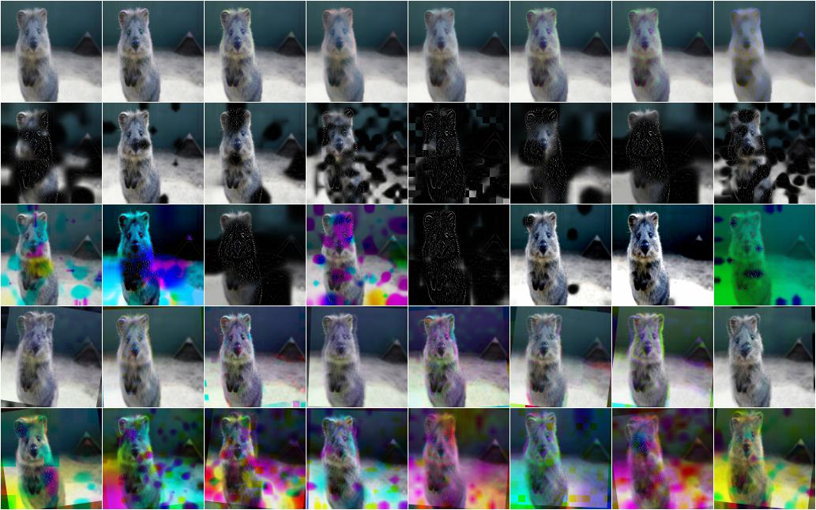
Data Augmentation
Increase diversity and amount of data
Helps network to learn about invariances
in data domain
Important for small and unbalanced
datasets

Slide 3

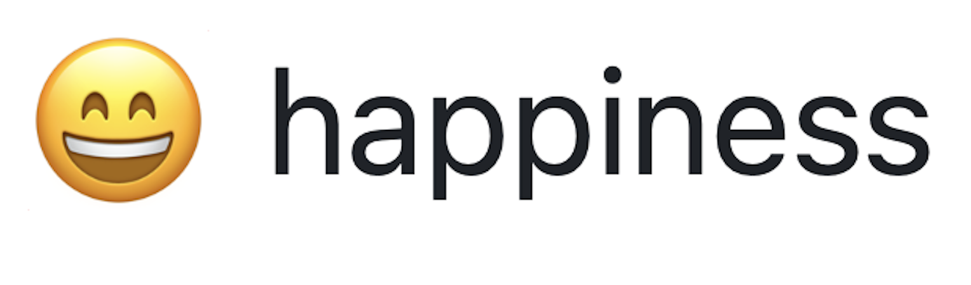
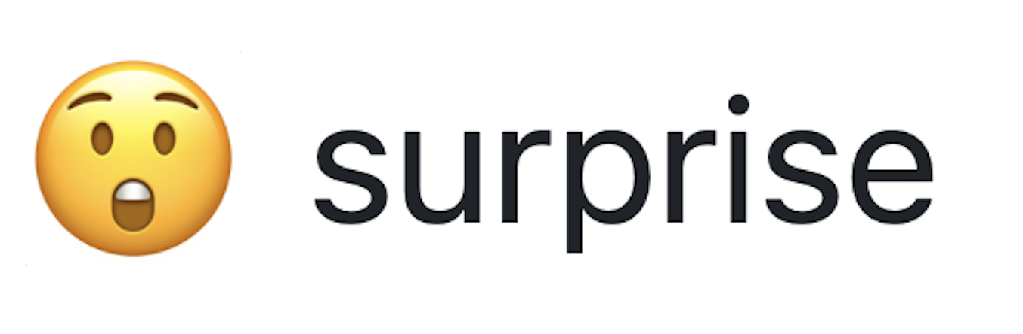

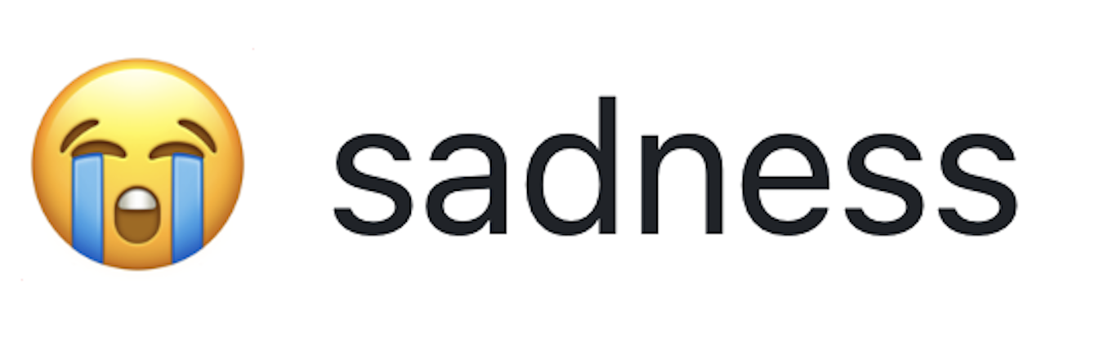
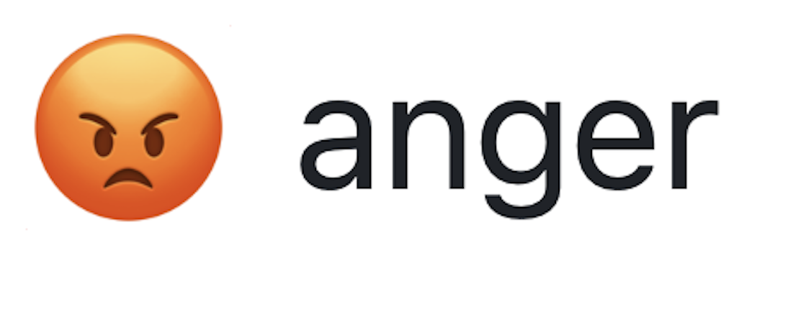

Data Augmentation
Valid acc : 0725
Valid acc : 0653
without DA
with DA
32
64
128
256
512

Slide 4



Visualization
and
Interpretability
Prof. Leal-Taixé and Prof. Niessner
1

Slide 5
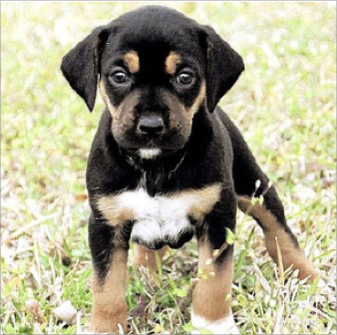


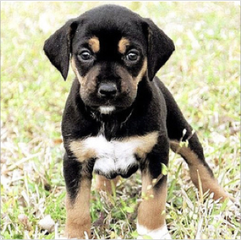


The occlusion experiment
Block different parts of the image and see how the classification score changes
DOG 0.95
The face of the dog is more important for correct classification
DOG 0.35
Zeiler and Fergus. „Visualizing and understanding convolutional neural networks“. ECCV 2014
Prof. Leal-Taixé and Prof. Niessner
12

Slide 6
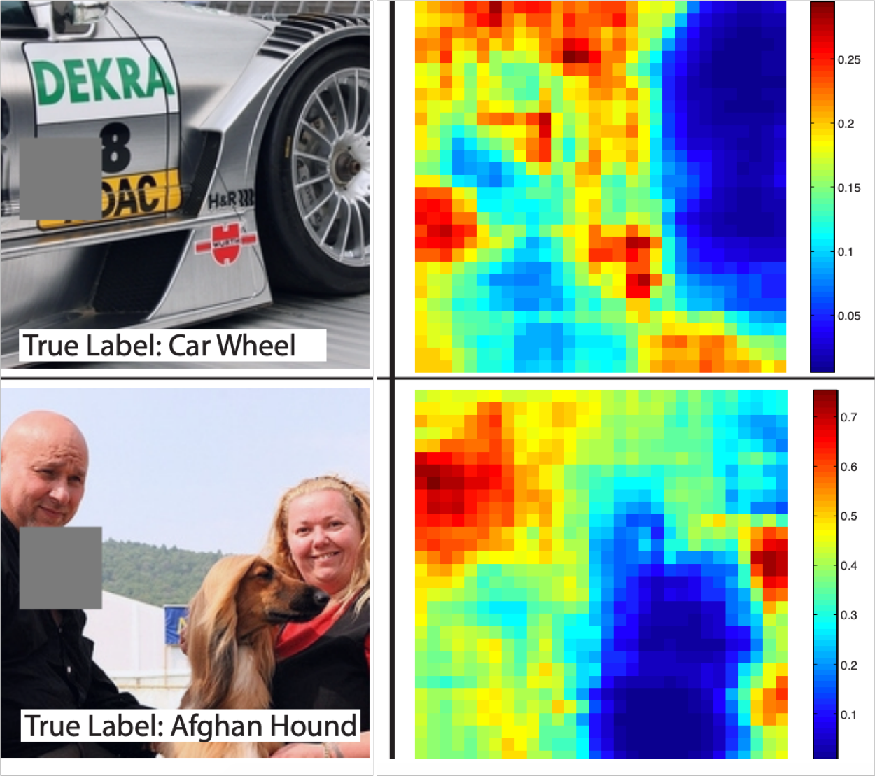

The occlusion experiment
Most important pixels for classification
Zeiler and Fergus. „Visualizing and understanding convolutional neural networks“. ECCV 2014
Prof. Leal-Taixé and Prof. Niessner
14

Slide 7
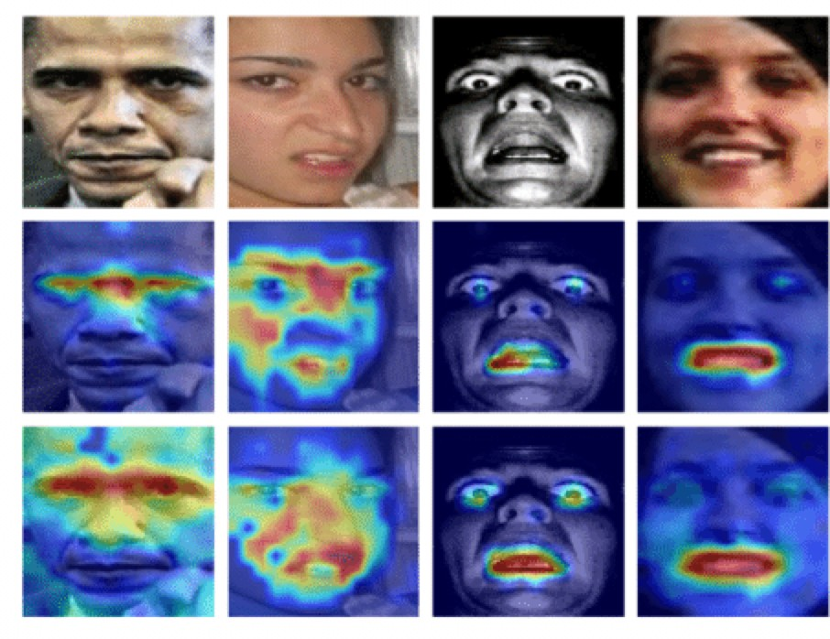
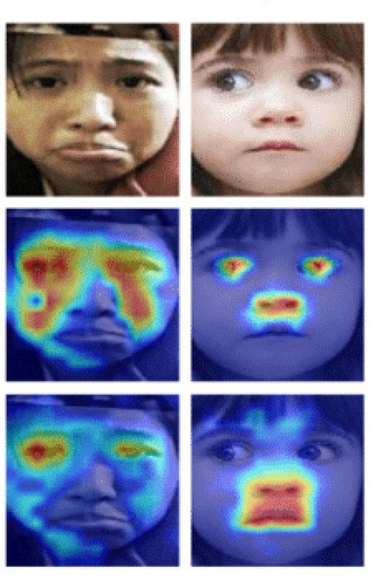
Visualization helps
Grad-CAM
• 2. Aliasing artifacts in the 2nd layer caused by the large stride
• Solution: stride 4 changed to stride 2
Anger
Disgust
Fear
Happiness
Sadness
Surprise
Prof. Leal-Taixé and Prof. Niessner

Slide 8
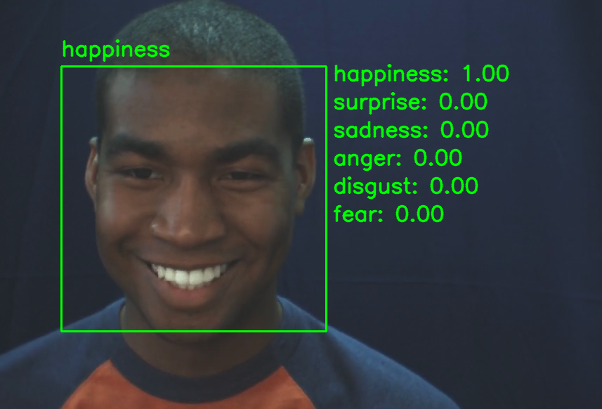
Demo Video

Slide 9
Demo Video

Slide 10
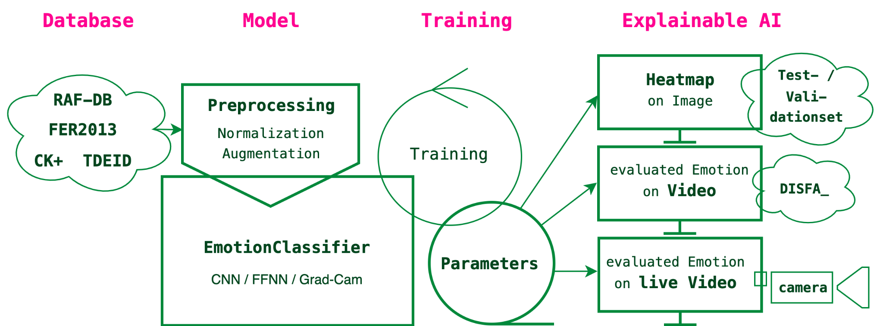
Global Experimental Pipeline
Notes:
Preprocessing Image Convolutional Neural Network, Feed Forward Neural Network, Gradient Class Activation Mapping,

Slide 11
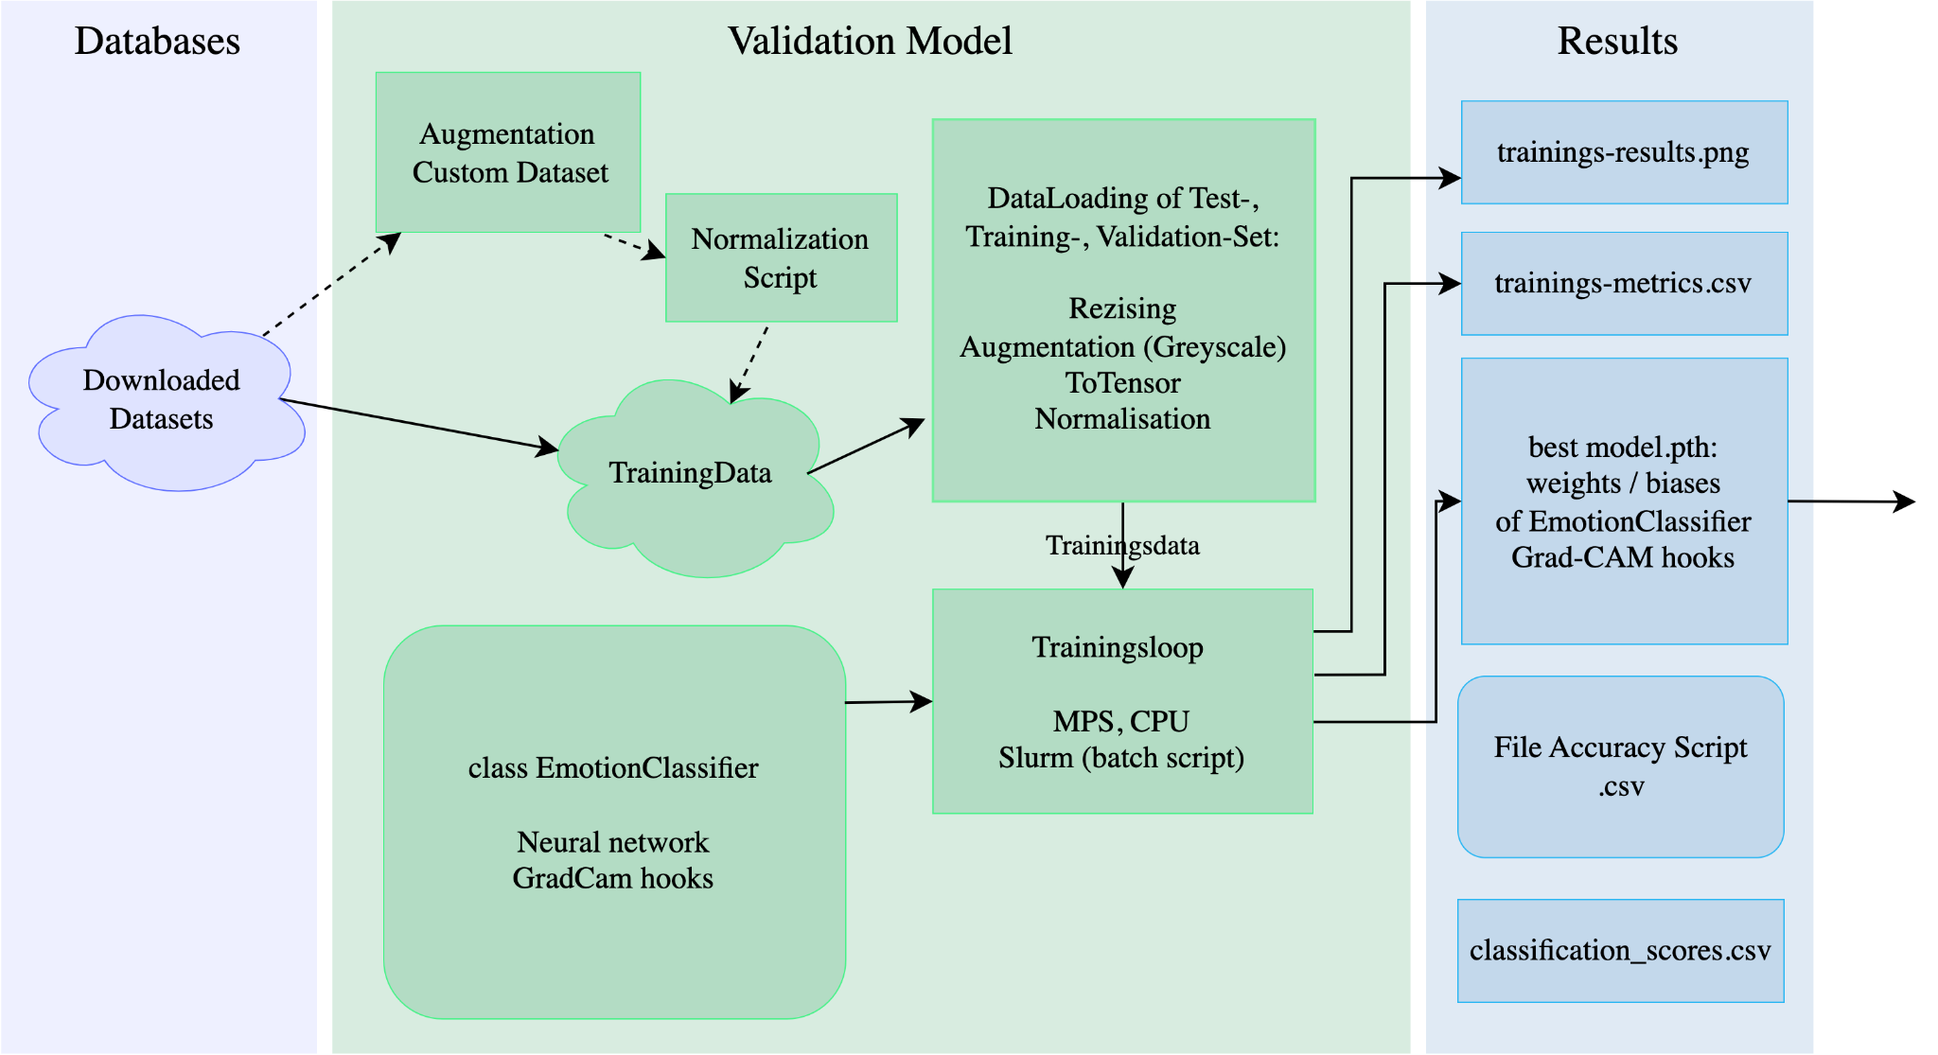
Detailed Experimental Pipeline
Notes:
Convolutional neural network, feed forward neural network, gradient Class Activation Mapping,

Slide 12
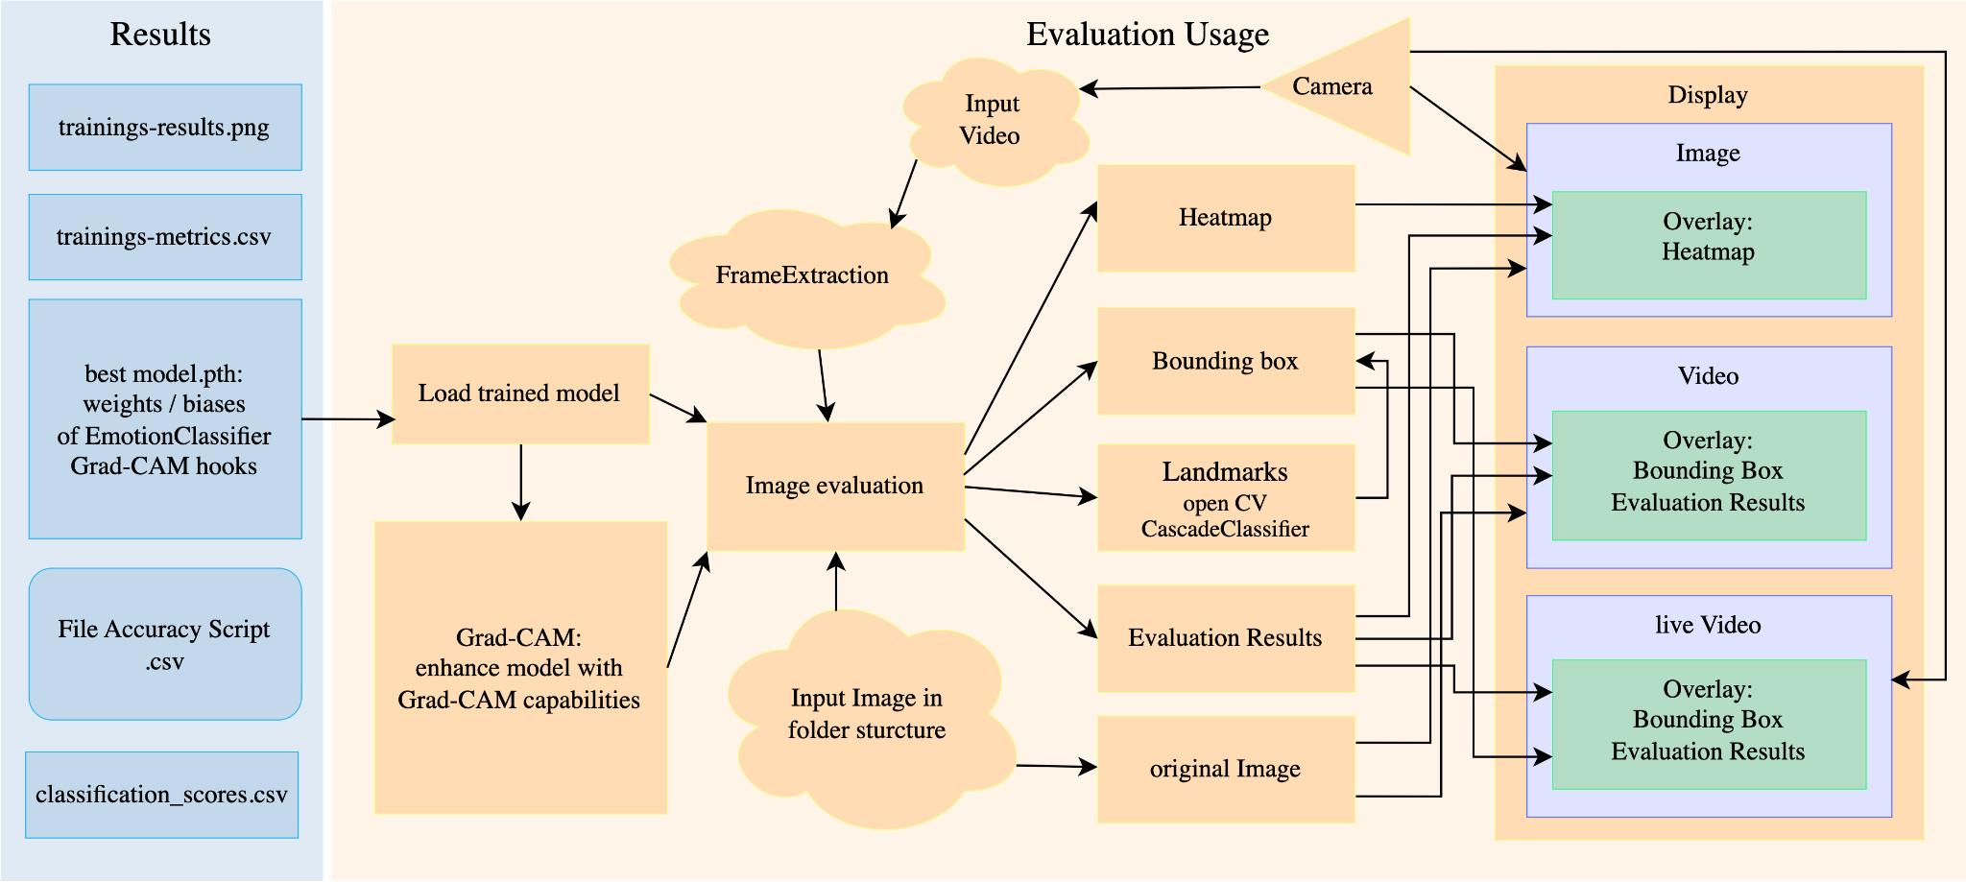
Detailed Experimental Pipeline
Notes:
Convolutional neural network, feed forward neural network, gradient Class Activation Mapping,

Slide 13
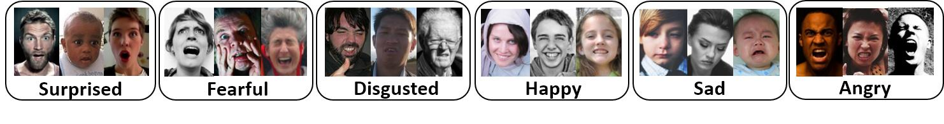
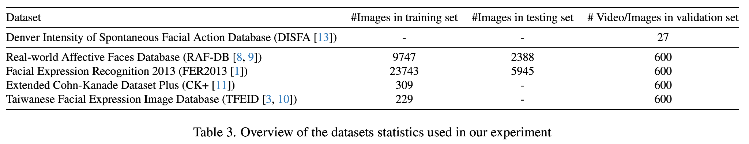
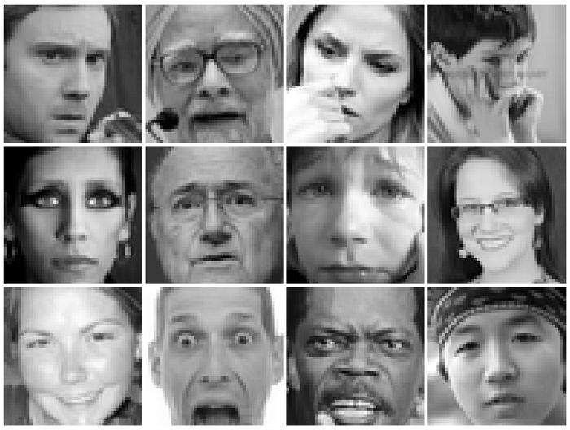
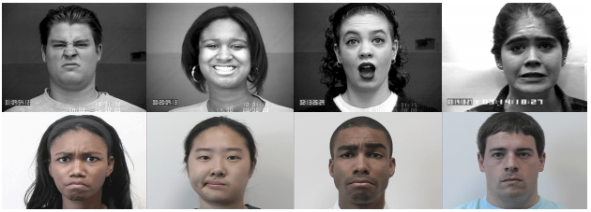
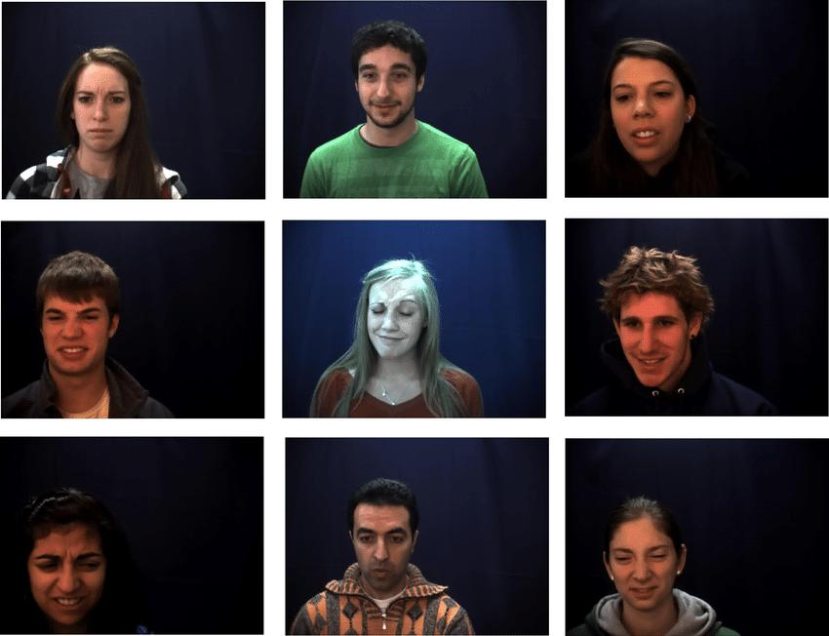
Datasets

Slide 14
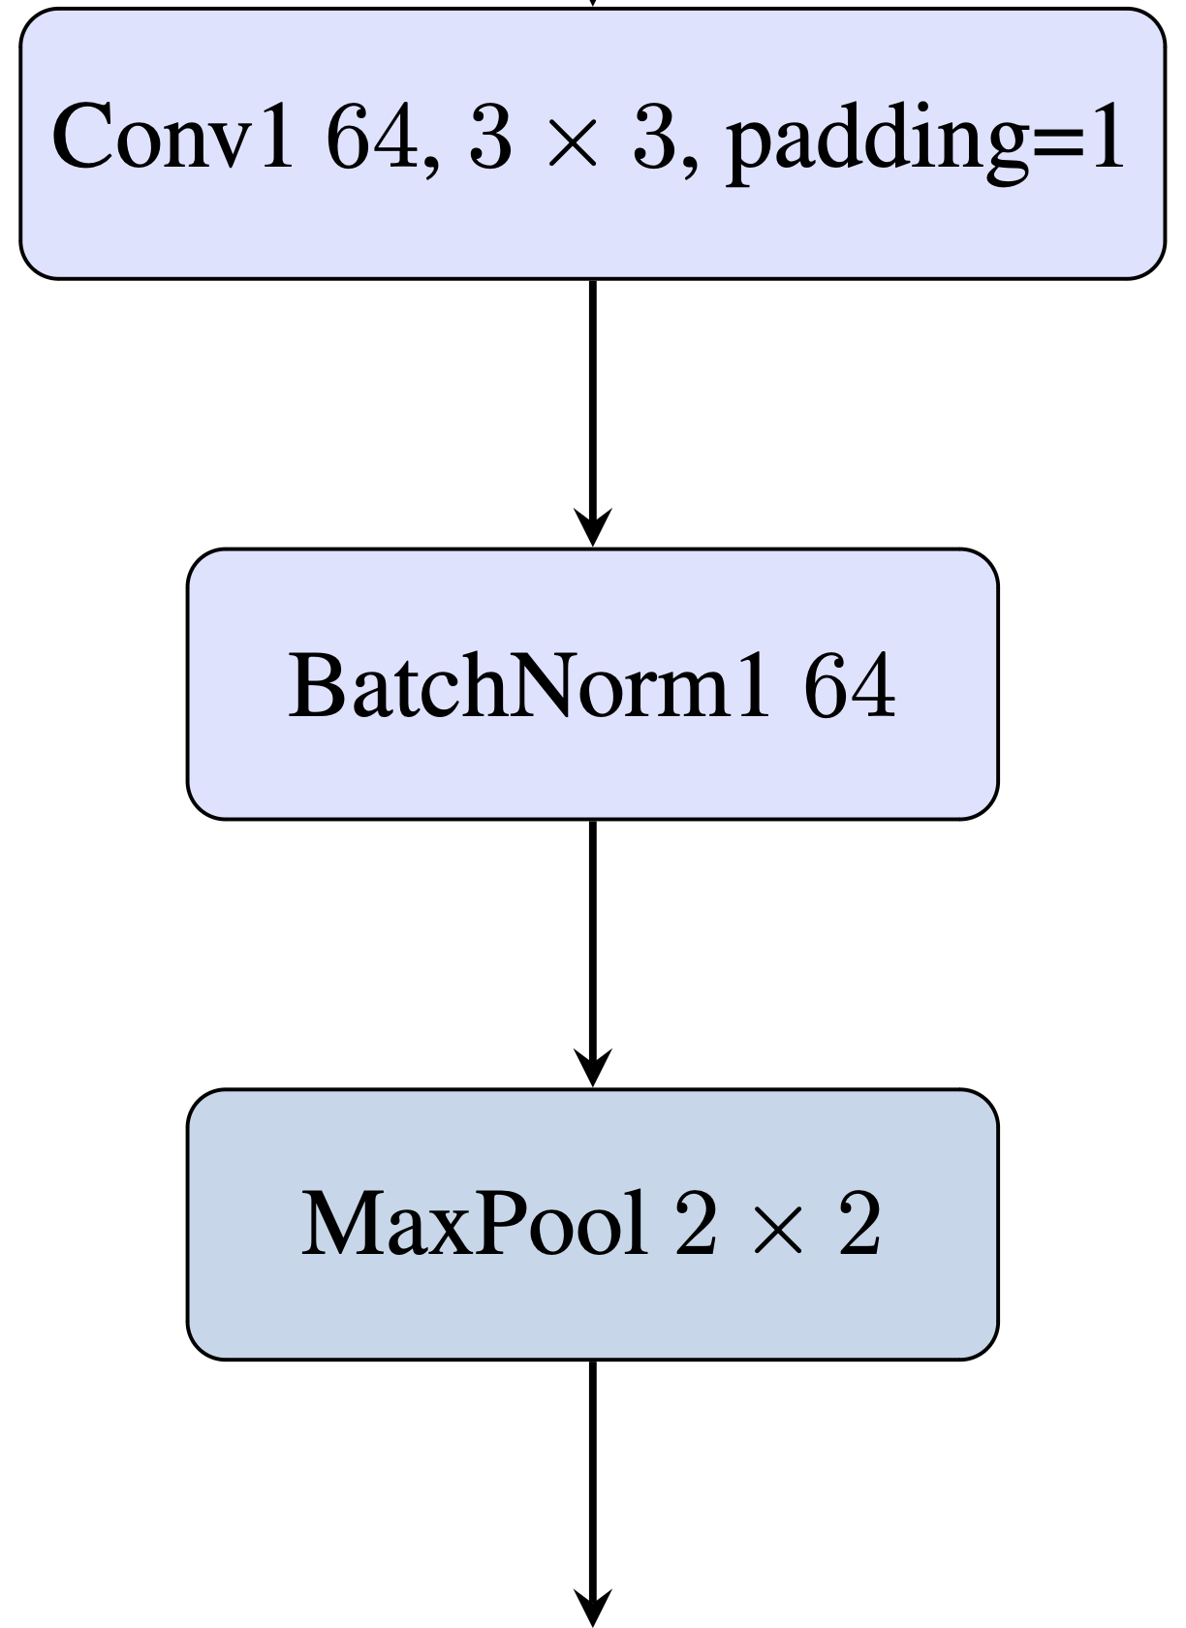
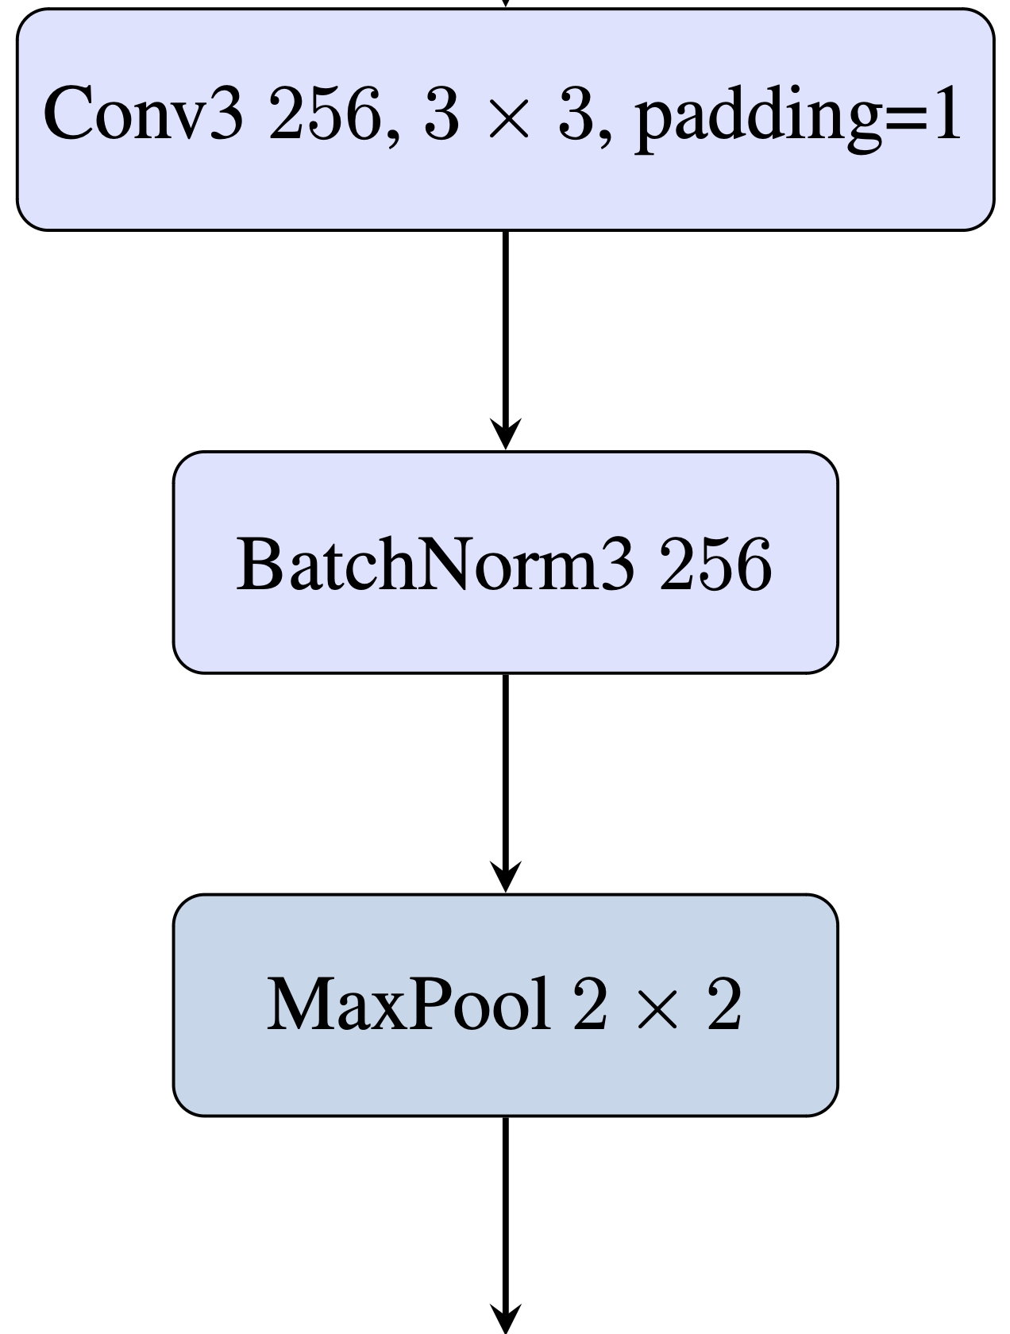
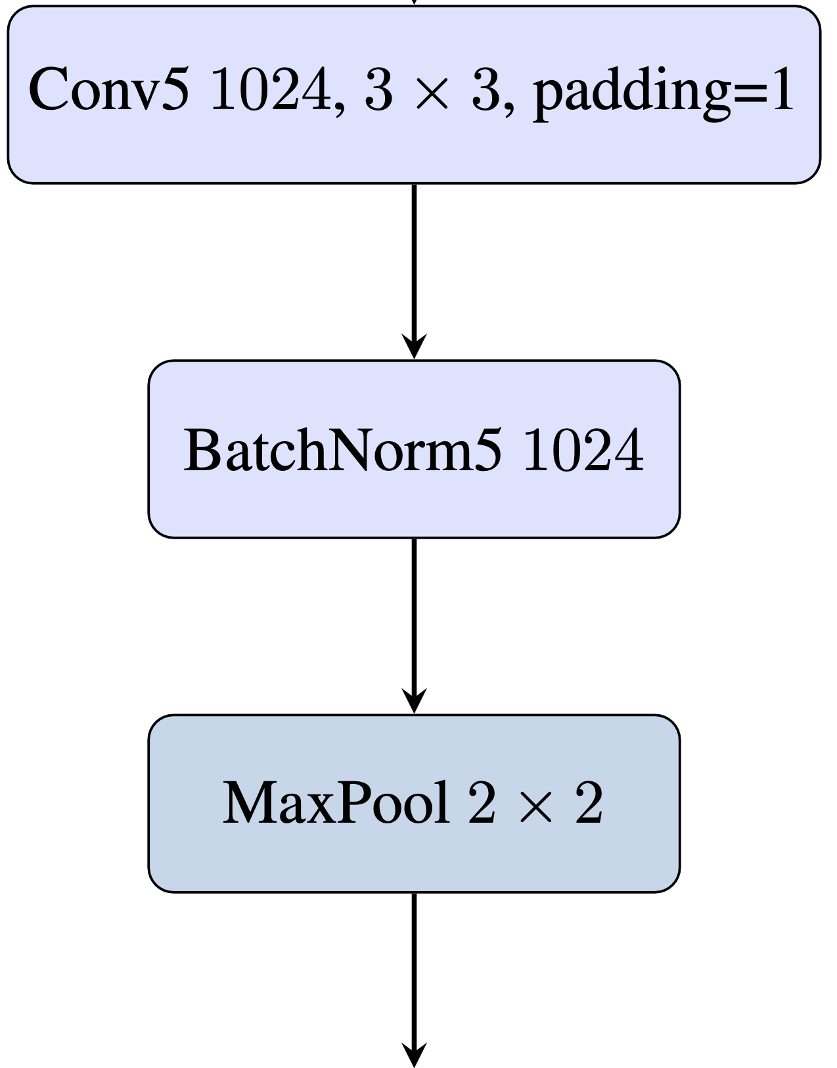
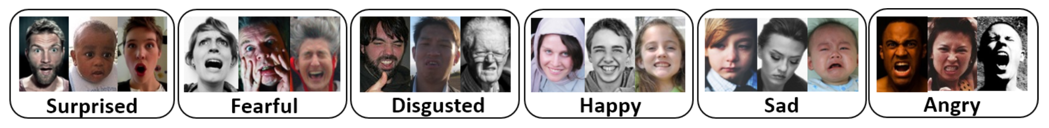
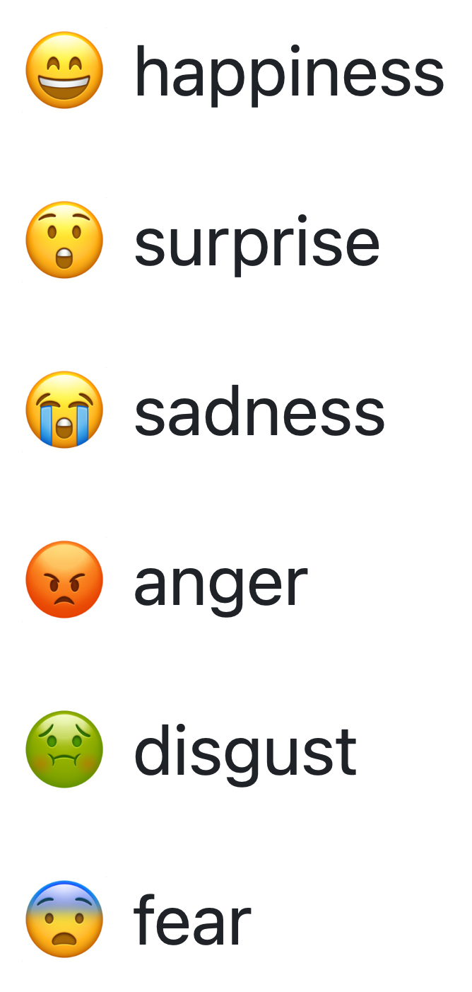
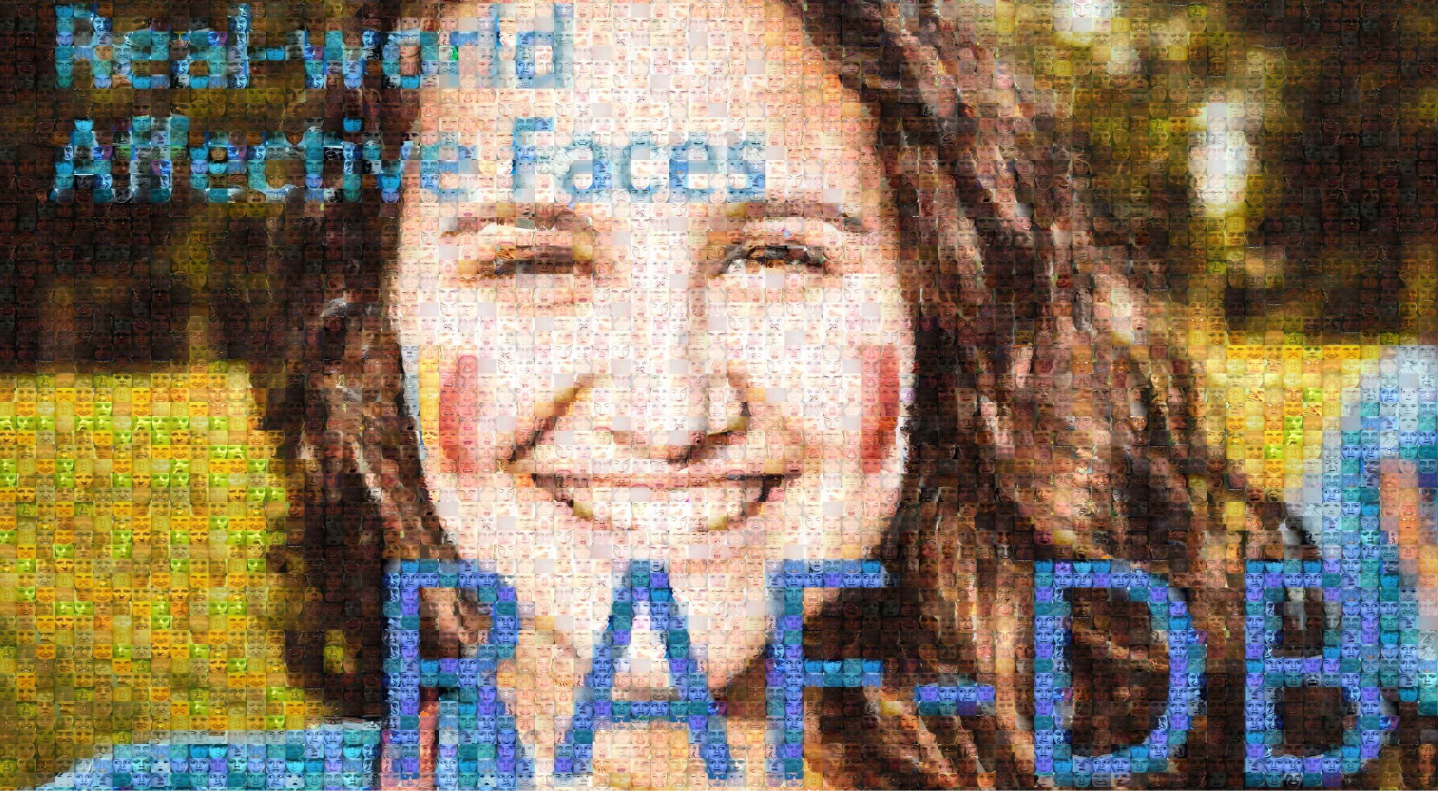
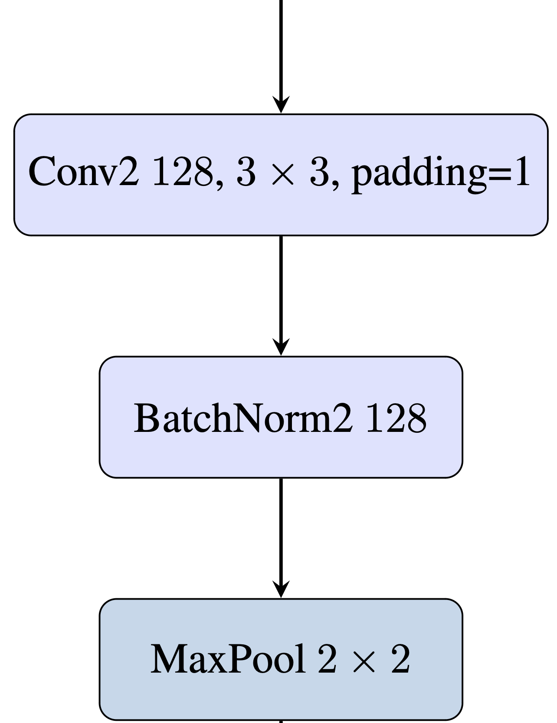
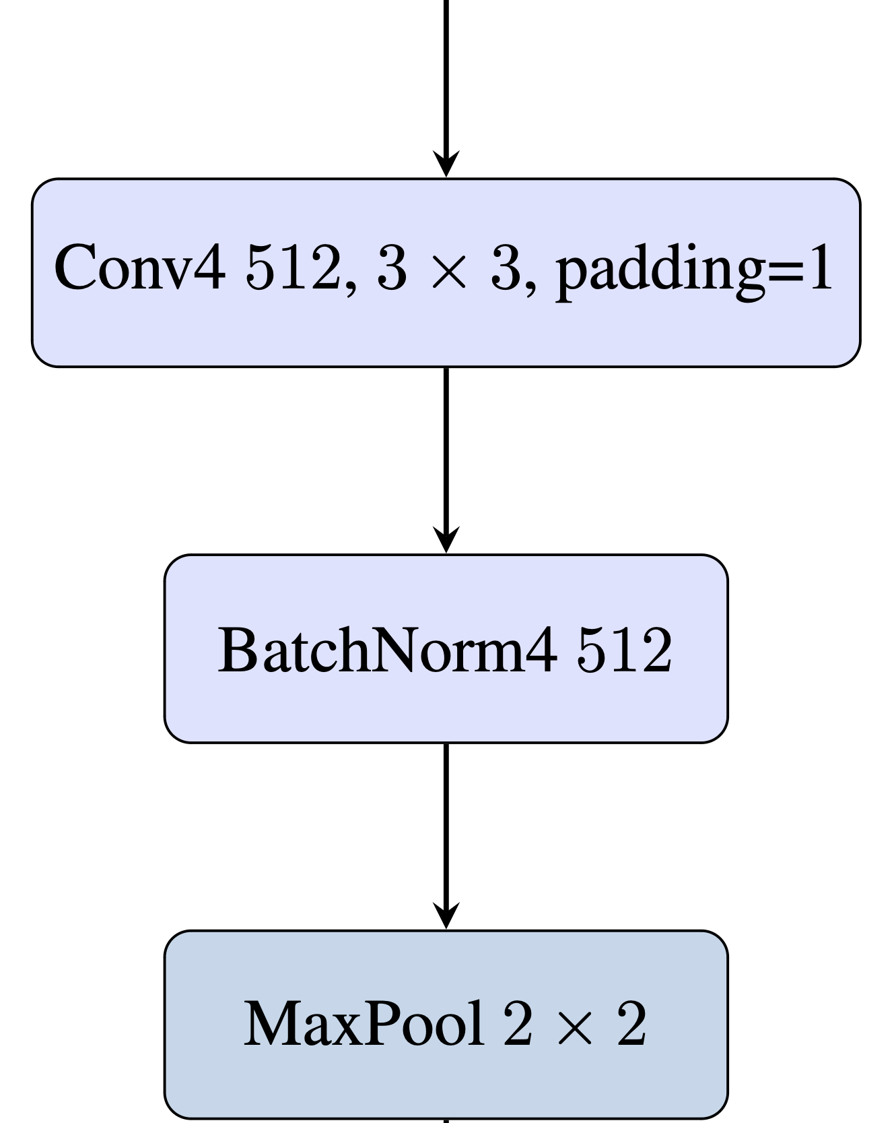
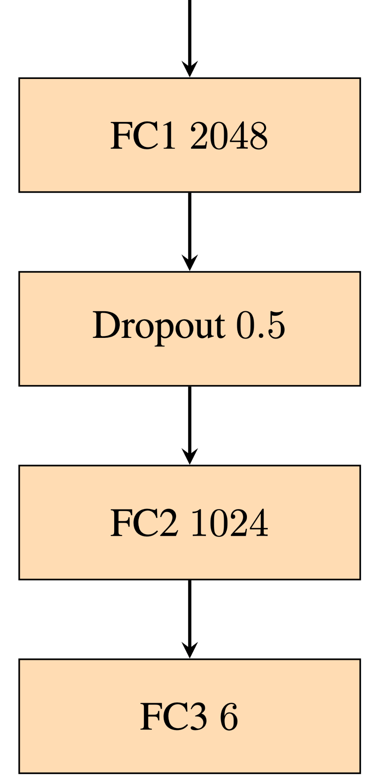

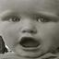
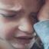


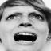
Model Architecture

Slide 15
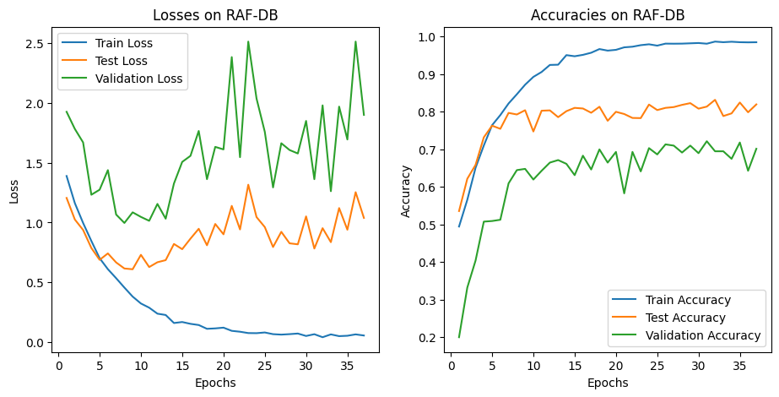
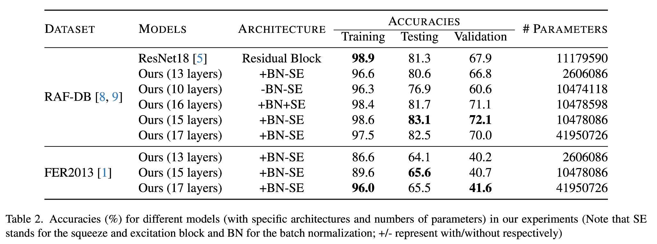
Empirical Results

Slide 16
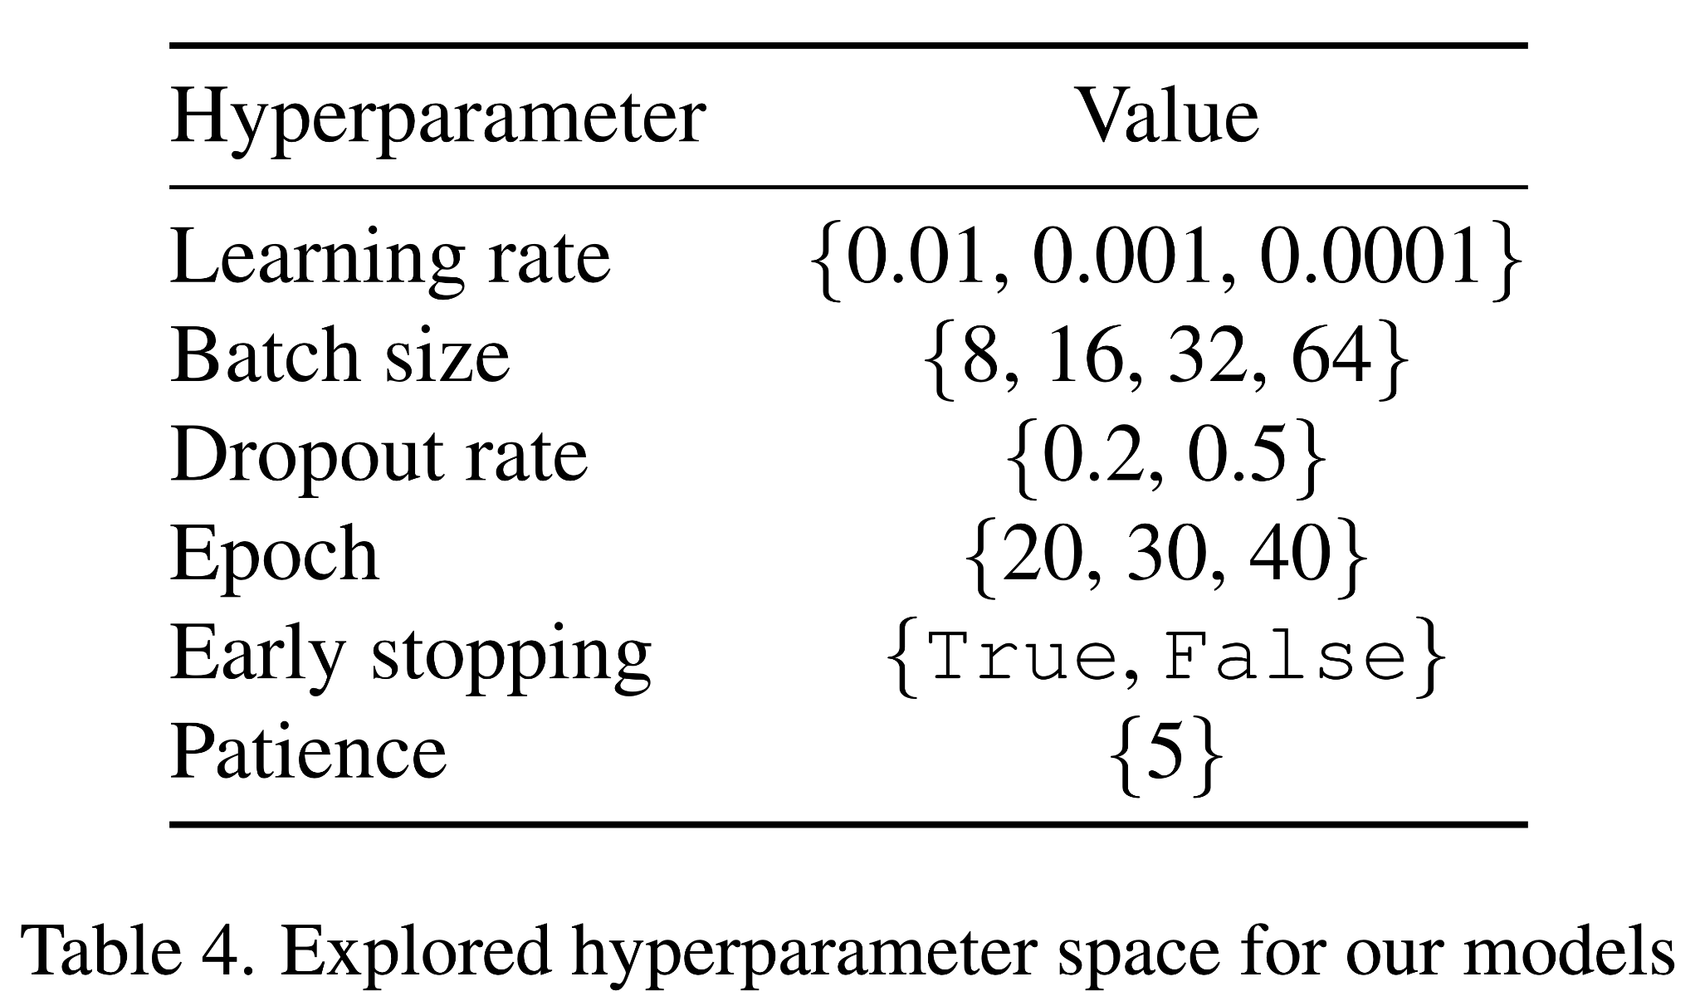
Explored Hyper-parameters

Slide 17
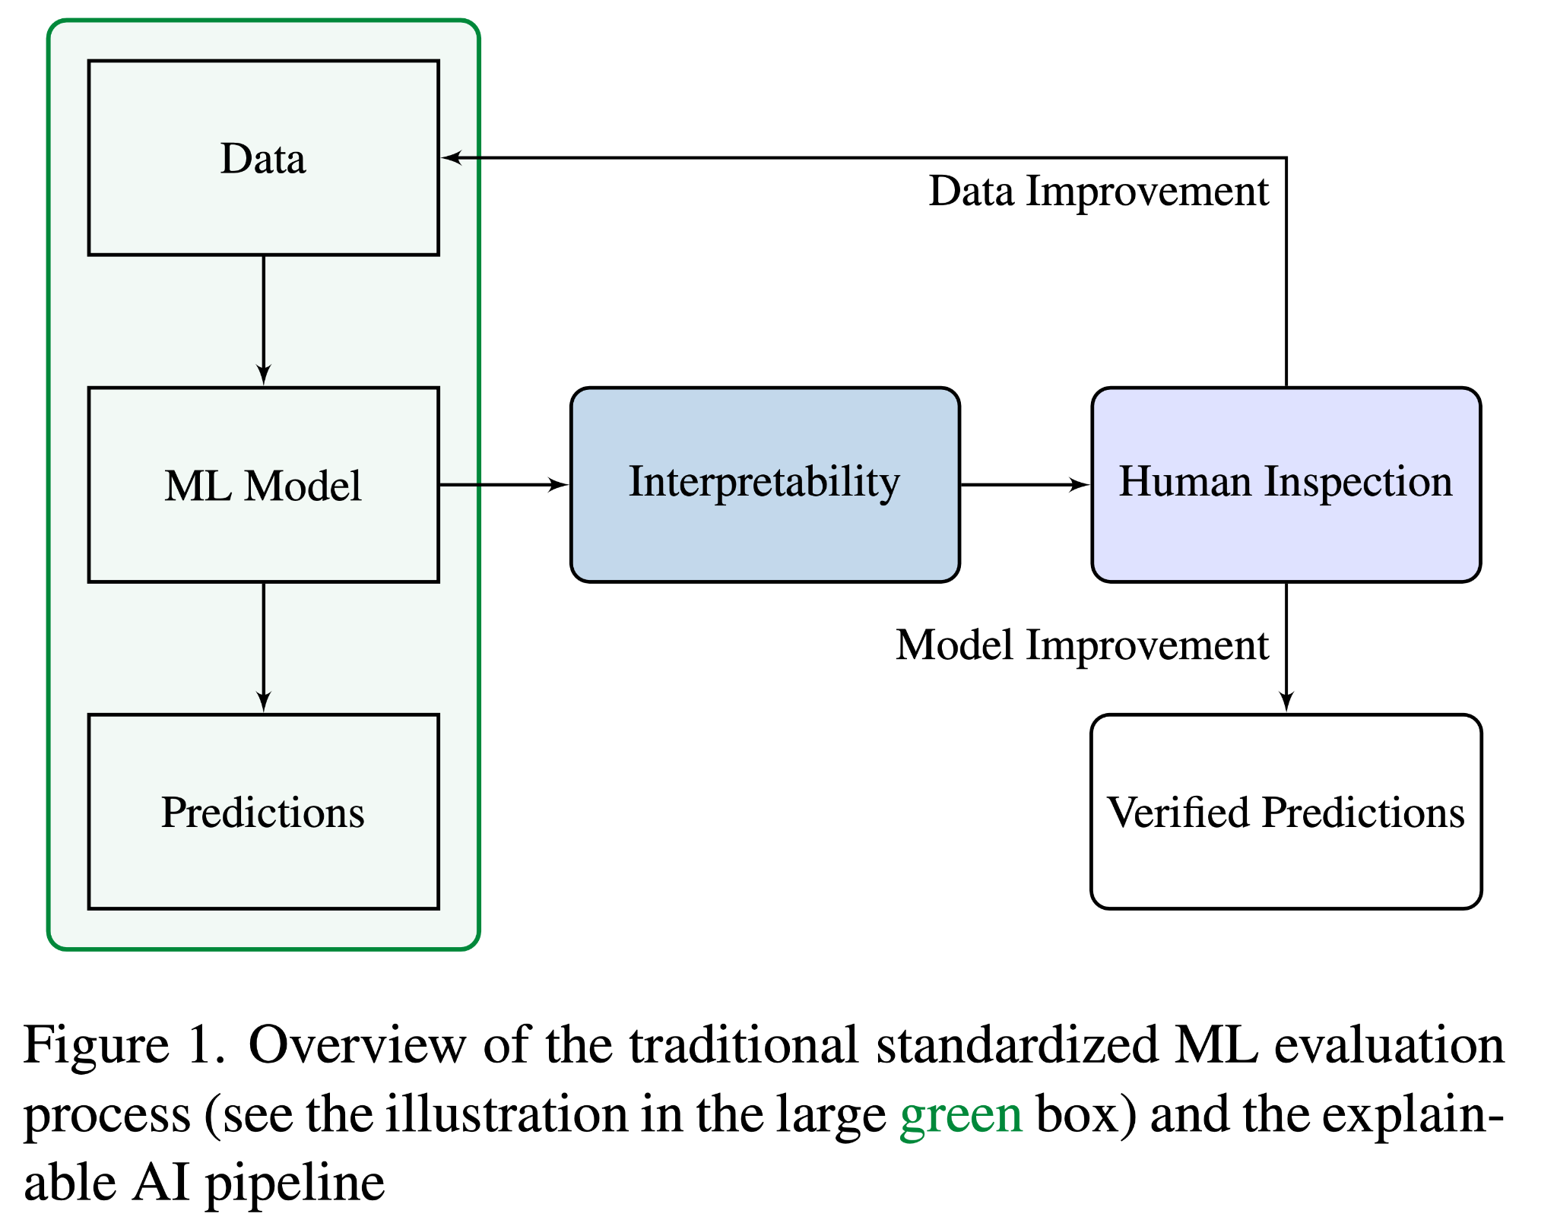
Why is interpretability important?
Know how models make decisions
Know what happened in models
Understand why
Understand why not
See when we succeed
See when we fail
Further improve the data
Further improve the model

Slide 18
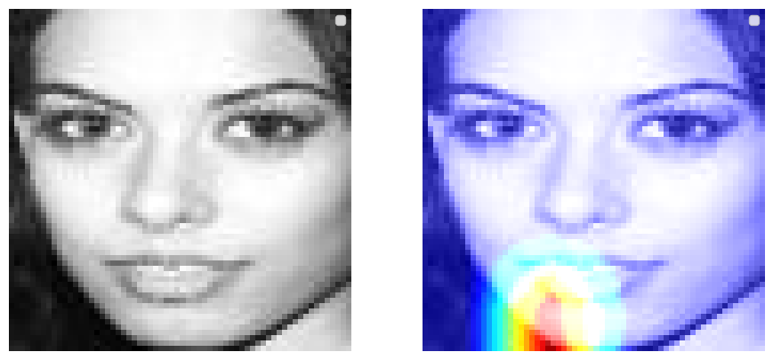
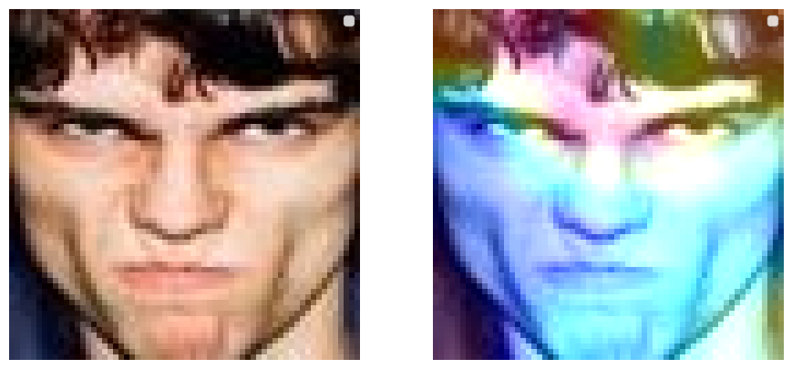
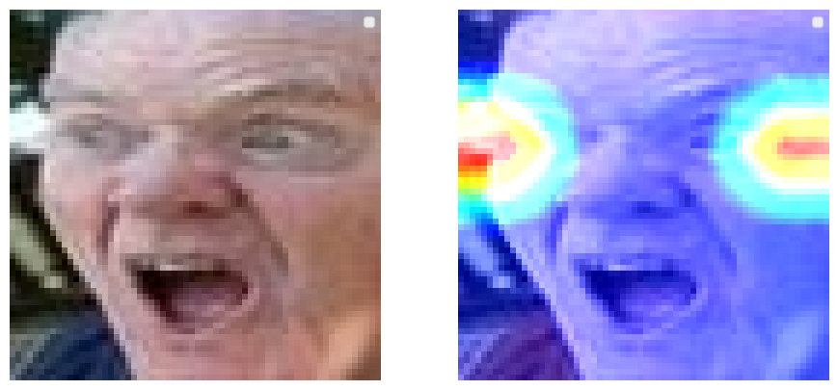
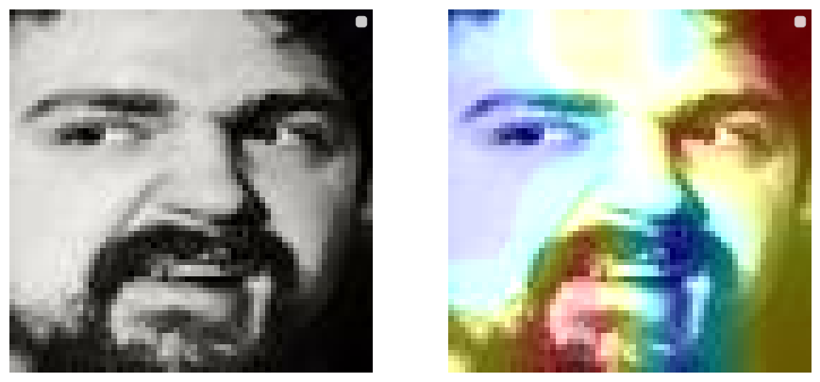
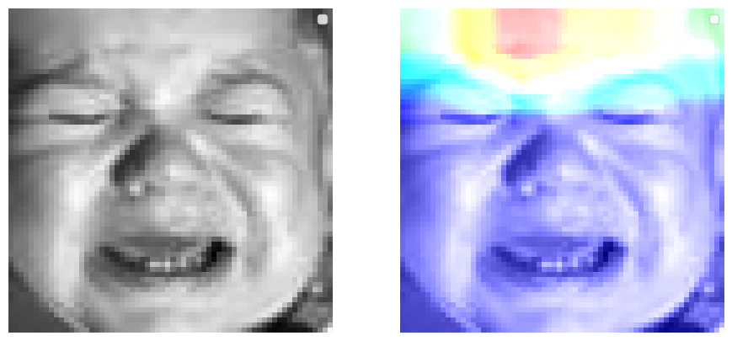
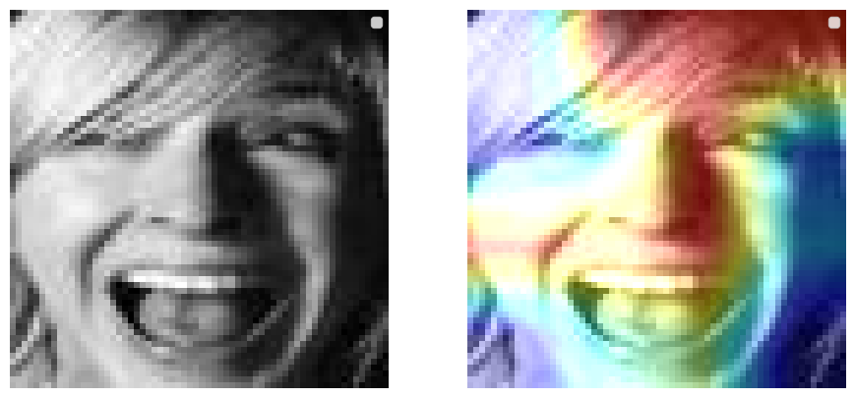
Interpretable Results (XAI)

Slide 19
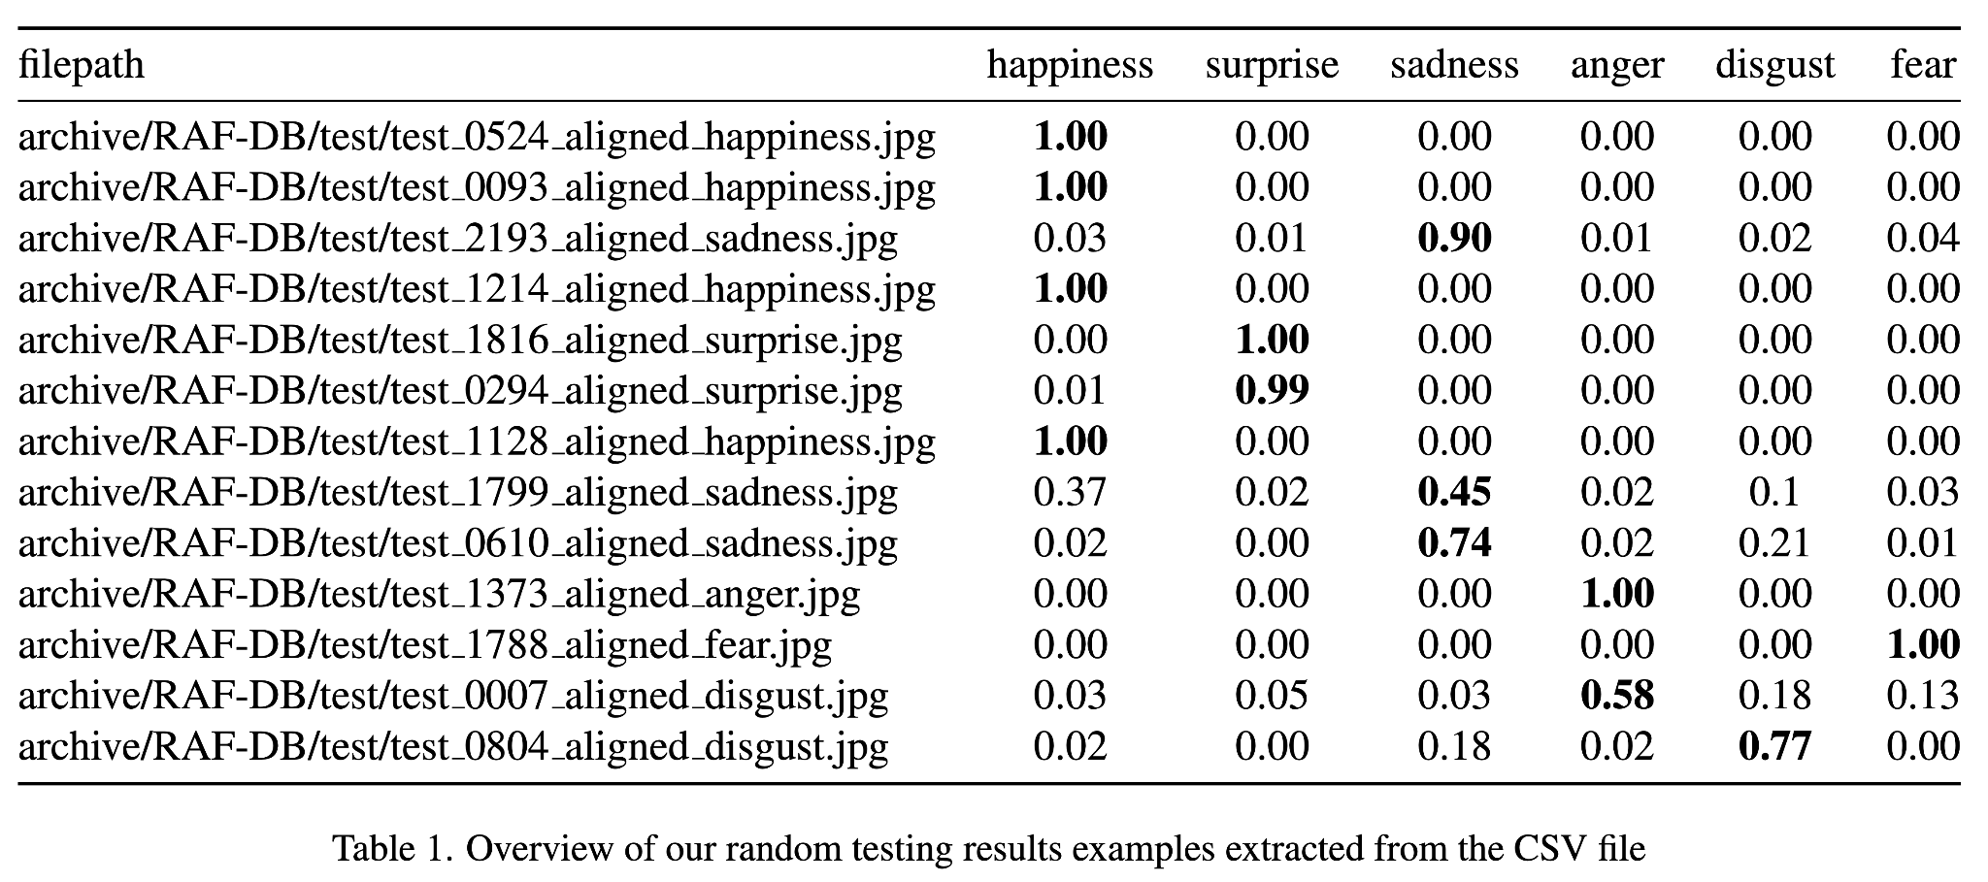
Classification Results

Slide 20
Live Demo 😄

Slide 21
Literature
[1] Emad Barsoum, Cha Zhang, Cristian Canton-Ferrer, and Zhengyou Zhang. Training deep networks for facial expression recognition with crowd-sourced label distribution. In Proceedings of the 18th ACM International Conference on Multimodal Interaction, ICMI 2016, Tokyo, Japan, November 12-16, 2016, pages 279–283. ACM, 2016.
[3] L.F. Chen and Y.S. Yen. Taiwanese facial expression image database, 2007.
[5] Kaiming He, Xiangyu Zhang, Shaoqing Ren, and Jian Sun. Deep residual learning for image recognition. In 2016 IEEE Conference on Computer Vision and Pattern Recognition, CVPR 2016, Las Vegas, NV, USA, June 27-30, 2016, pages 770–778. IEEE Computer Society, 2016.
[8] Shan Li and Weihong Deng. Reliable crowdsourcing and deep locality-preserving learning for unconstrained facial expression recognition. IEEE Transactions on Image Processing, 28(1):356–370, 2019.
[9] Shan Li, Weihong Deng, and Junping Du. Reliable crowd-sourcing and deep locality-preserving learning for expression recognition in the wild. In 2017 IEEE Conference on Computer Vision and Pattern Recognition, CVPR 2017, Honolulu, HI, USA, July 21-26, 2017, pages 2584–2593. IEEE Computer Society, 2017.
[10] Shanshan Li, Liang Guo, and Jianya Liu. Towards east asian facial expression recognition in the real world: A new database and deep recognition baseline. Sensors, 22(21): 8089, 2022.
[11] Patrick Lucey, Jeffrey F. Cohn, Takeo Kanade, Jason M. Saragih, Zara Ambadar, and Iain A. Matthews. The extended cohn-kanade dataset (CK+): A complete dataset for action unit and emotion-specified expression. In IEEE Conference on Computer Vision and Pattern Recognition, CVPR Workshops 2010, San Francisco, CA, USA, 13-18 June, 2010, pages 94–101. IEEE Computer Society, 2010.
https://www.kaggle.com/datasets/shuvoalok/raf-db-dataset
https://www.kaggle.com/datasets/msambare/fer2013
http://www.whdeng.cn/raf/model1.html
http://mohammadmahoor.com/disfa/

Slide 22
Thanks for your attention!
Any questions or remarks?
Mahdi Mohammadi, Leah Kawka, Jiawen Wang

Slide 23
Backup Appendix 😄

Slide 24
Slurm (Leah)

